Slide 1
Filter Design Techniques Chapter-7
Content and Figures are from Discrete-Time Signal Processing, 2e by Oppenheim, Shafer, and Buck, ©1999-2000 Prentice Hall Inc.

Slide 2
Filter Design Techniques
Any discrete-time system that modifies certain frequencies
Frequency-selective filters pass only certain frequencies
Filter Design Steps
Specification
Problem or application specific
Approximation of specification with a discrete-time system
Our focus is to go from spec to discrete-time system
Implementation
Realization of discrete-time systems depends on target technology
We already studied the use of discrete-time systems to implement a continuous-time system
If our specifications are given in continuous time we can use
C/D
H(e^{jω})
D/C
xc(t)
yr(t)

Slide 3
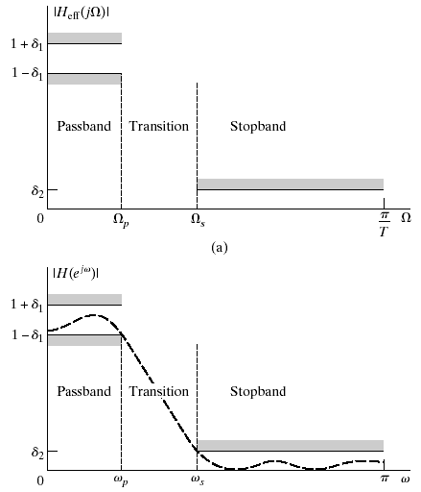
Filter Specifications
Specifications
Passband
Stopband
Parameters
Specs in dB
Ideal passband gain =20log(1) = 0 dB
Max passband gain = 20log(1.01) = 0.086dB
Max stopband gain = 20log(0.001) = -60 dB

Slide 4
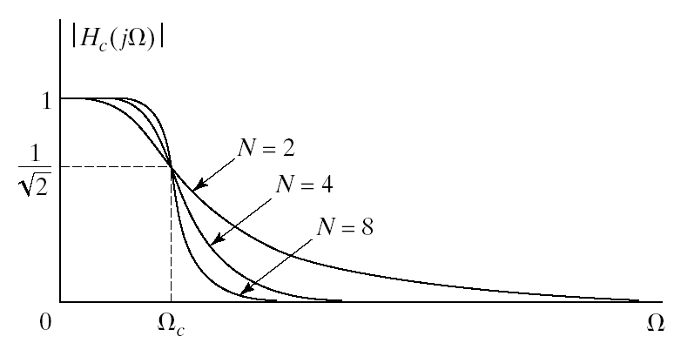
Butterworth Lowpass Filters
Passband is designed to be maximally flat
The magnitude-squared function is of the form

Slide 5
Filter Design by Impulse Invariance
Remember impulse invariance
Mapping a continuous-time impulse response to discrete-time
Mapping a continuous-time frequency response to discrete-time
If the continuous-time filter is bandlimited to
If we start from discrete-time specifications
- Start with discrete-time spec in terms of ω
Go to continuous-time Ω= ω /T and design continuous-time filter
Use impulse invariance to map it back to discrete-time ω= ΩT
Works best for bandlimited filters due to possible aliasing

Slide 6
Impulse Invariance of System Functions
Develop impulse invariance relation between system functions
Partial fraction expansion of transfer function
Corresponding impulse response
Impulse response of discrete-time filter
System function
Pole s=s_{k} in s-domain transform into pole at

Slide 7
Impulse Invariance of System Functions
Develop impulse invariance relation between system functions
Partial fraction expansion of transfer function
Corresponding impulse response
Impulse response of discrete-time filter
System function
Pole s=s_{k} in s-domain transform into pole at
Why?

Slide 8
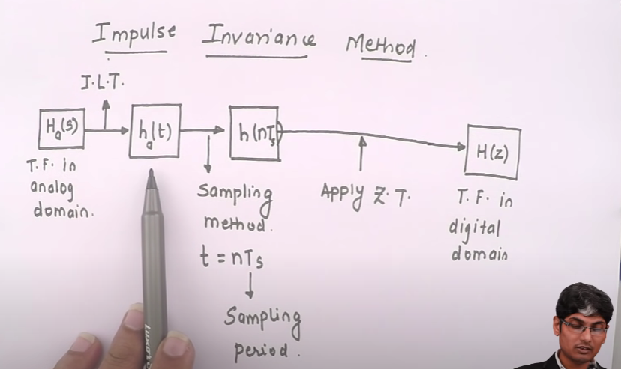

Slide 9
Example
Impulse invariance applied to Butterworth
Since sampling rate T_{d} cancels out we can assume T_{d}=1
Map spec to continuous time
Butterworth filter is monotonic so spec will be satisfied if
Determine N and Ω_{c} to satisfy these conditions

Slide 10

Example Cont’d
Satisfy both constrains
Solve these equations to get
Put $Ω_{c}$ and N in
N must be an integer so we round it up to meet the spec
Poles of transfer function
The transfer function
Mapping to z-domain

Slide 11
Example Cont’d
Satisfy both constrains
Solve these equations to get
Put $Ω_{c}$ and N in
N must be an integer so we round it up to meet the spec
Poles of transfer function
The transfer function
Mapping to z-domain

Slide 12
Filter Design by Bilinear Transformation
Get around the aliasing problem of impulse invariance
Map the entire s-plane onto the unit-circle in the z-plane
Nonlinear transformation
Frequency response subject to warping
Bilinear transformation
Transformed system function
We can solve the transformation for z as
Maps the left-half s-plane into the inside of the unit-circle in z
Stable in one domain would stay in the other depending on value of $σ$

Slide 13
Bilinear Transformation
On the unit circle put $s=jΩ$ the transform becomes
To derive the relation between ω and Ω
Which yields

Slide 14
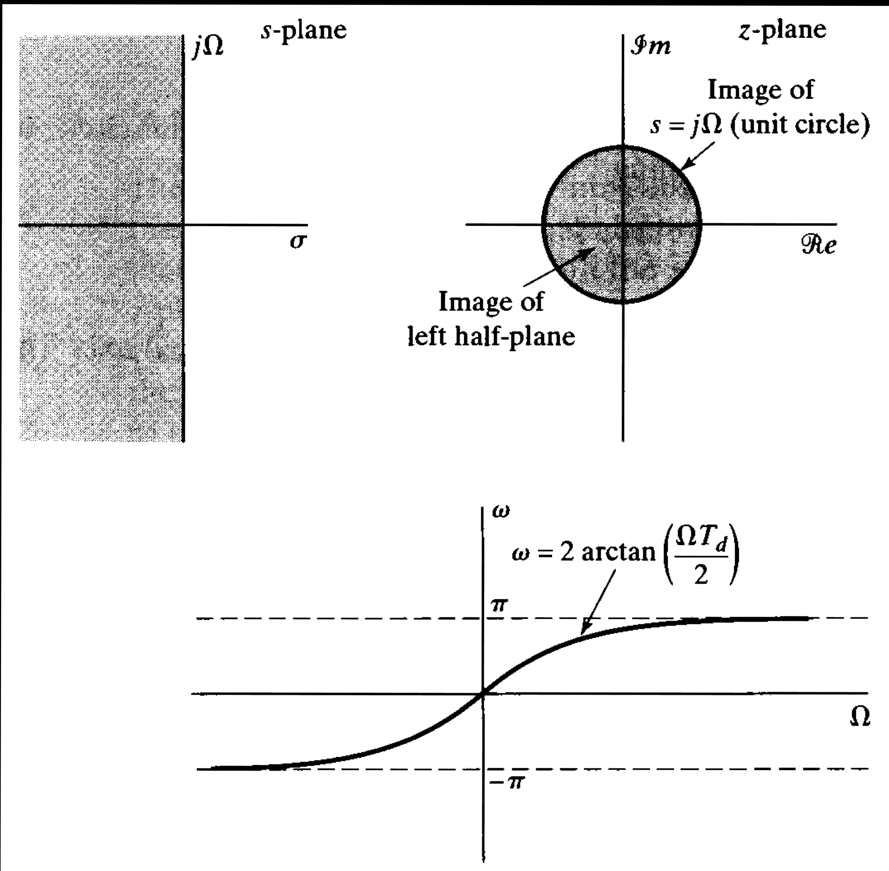
Bilinear Transformation

Slide 15
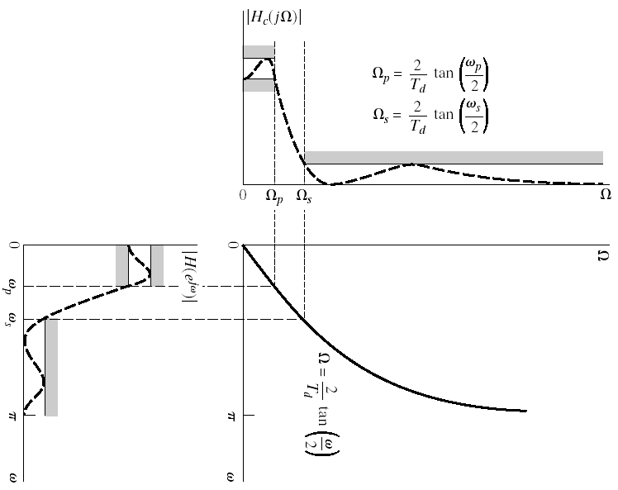
Bilinear Transformation

Slide 16
Example
Bilinear transform applied to Butterworth
Apply bilinear transformation to specifications
We can assume T_{d}=1 and apply the specifications to
To get

Slide 17
Example Cont’d
Solve N and Ω_{c}
The resulting transfer function has the following poles
Resulting in
Applying the bilinear transform yields

